Slide 1
医学信息资源培训
  PubMed
  www.pubmed.gov

Slide 2
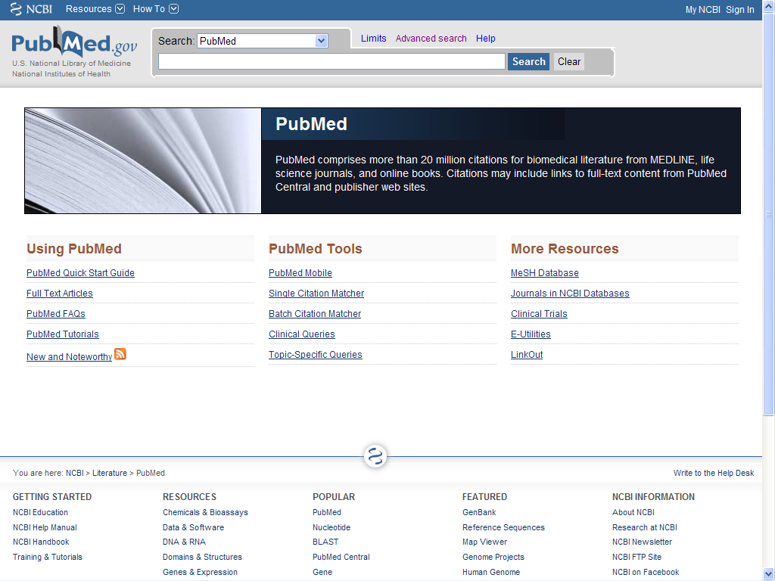
Stomach Cancer OR Stomach Tumor OR Stomach Tumour OR Stomach Neoplasms

Slide 3
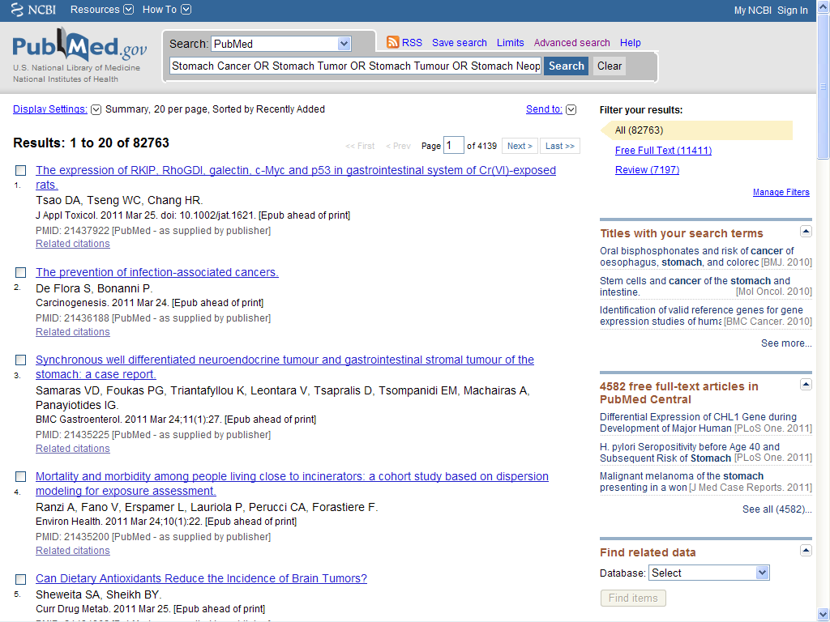

Slide 4
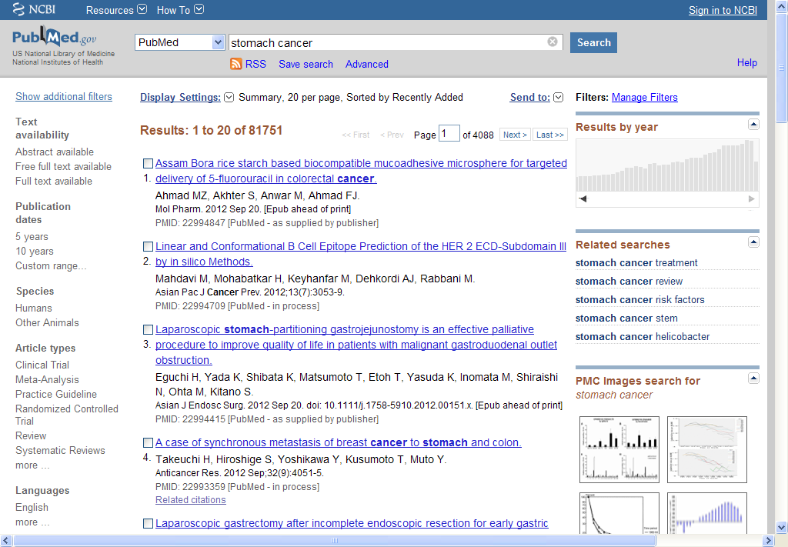

Slide 5
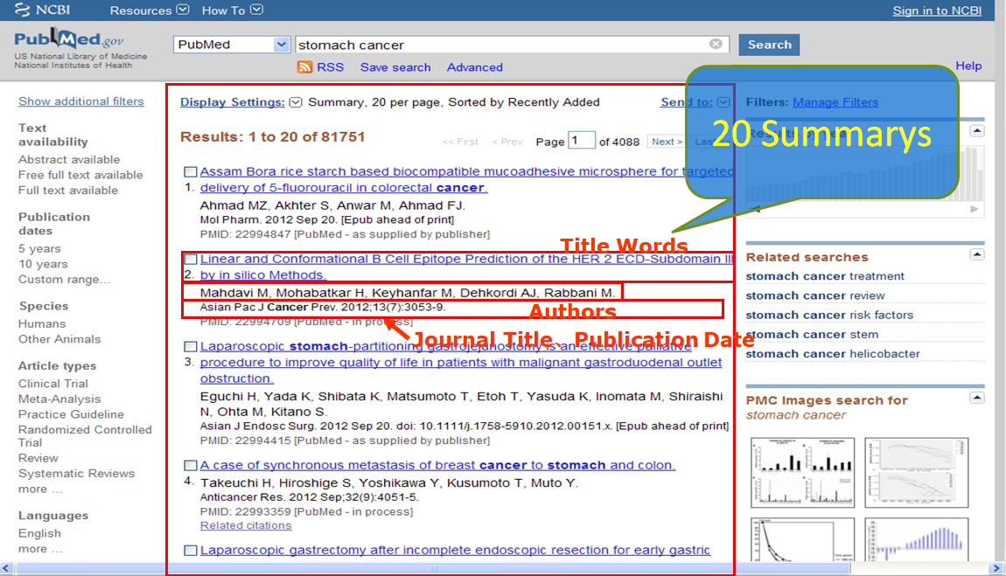

Slide 6
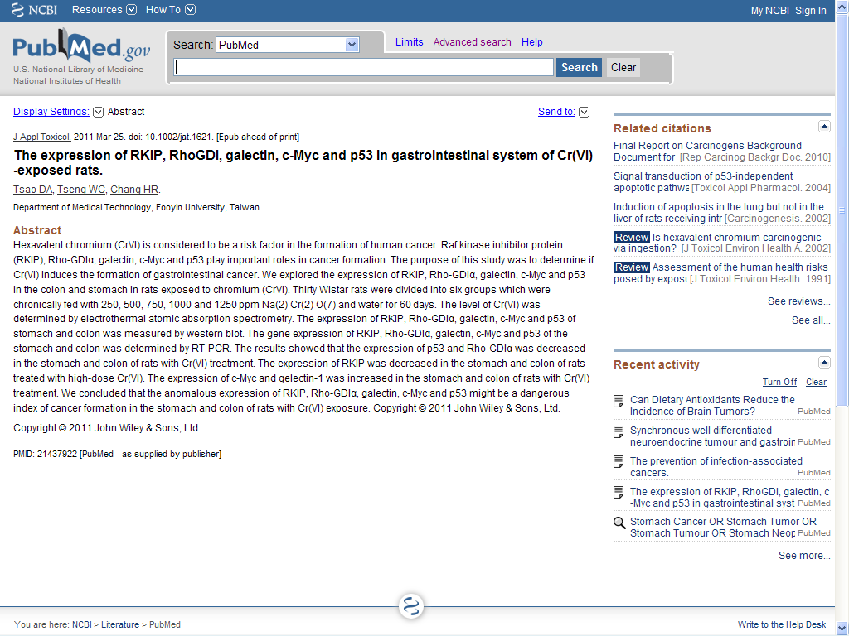
Journal Title、Publication Date
Authors
Title Words
Affilication
Search the same topic articles from Title\Abstract\MeSH
Unique Identifiers
Abstract

Slide 7
[PubMed - indexed for MEDLINE]
[PubMed - as supplied by publisher]
较新或较老的文献
[PubMed - in process]
[PubMed - OLDMEDLINE]
[PubMed]

Slide 8
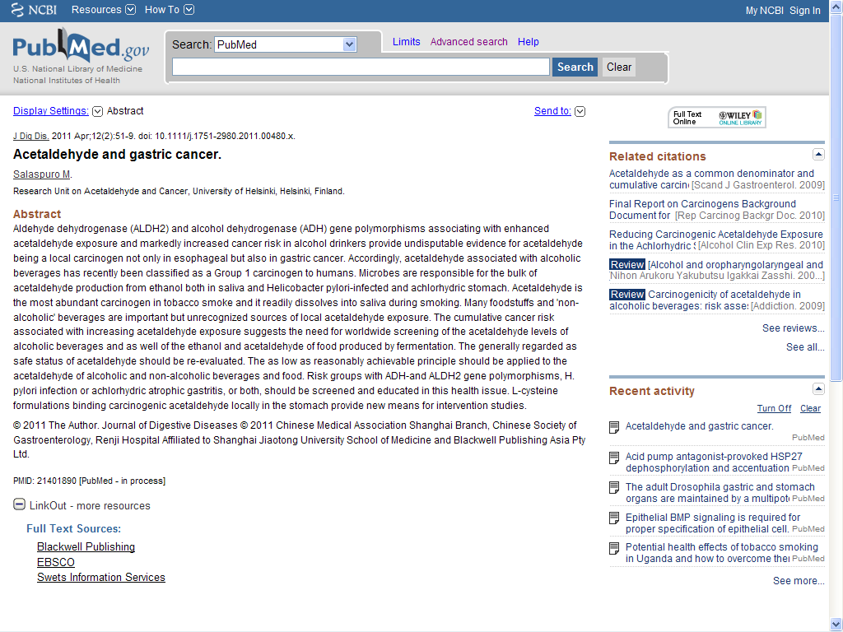
FullText HyperLink
LinkOut

Slide 9
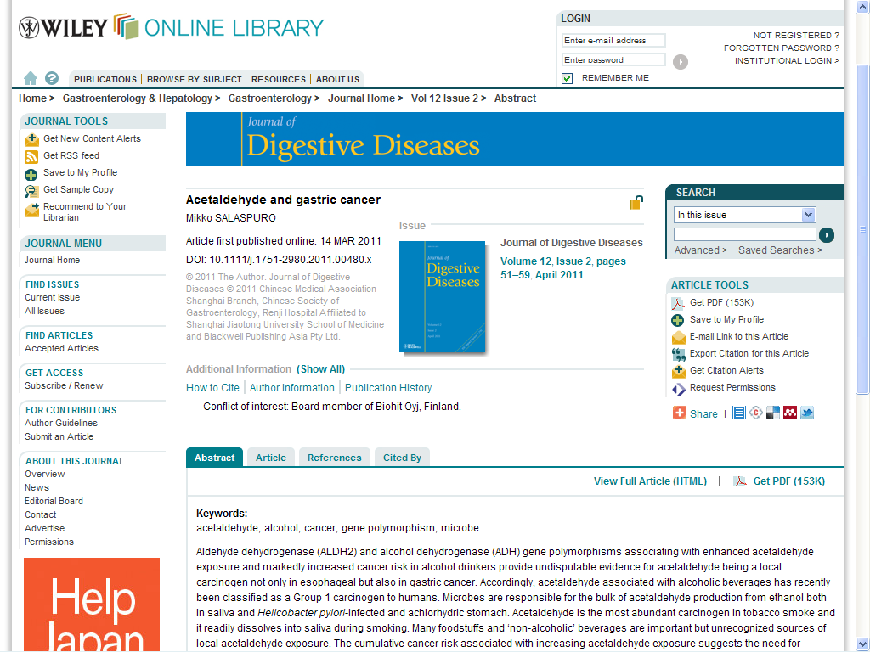
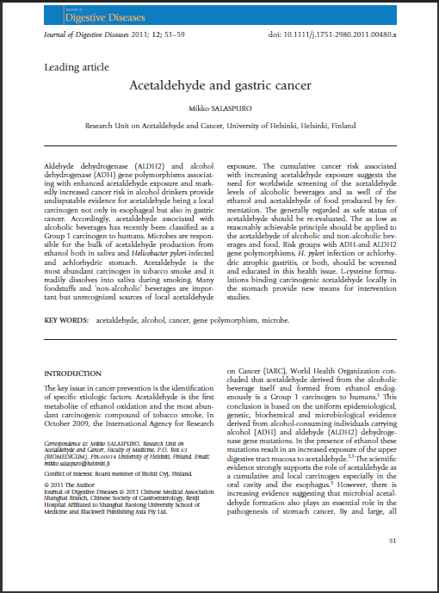

Slide 10
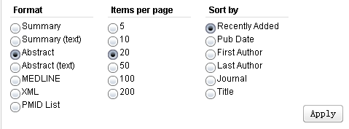

Slide 11
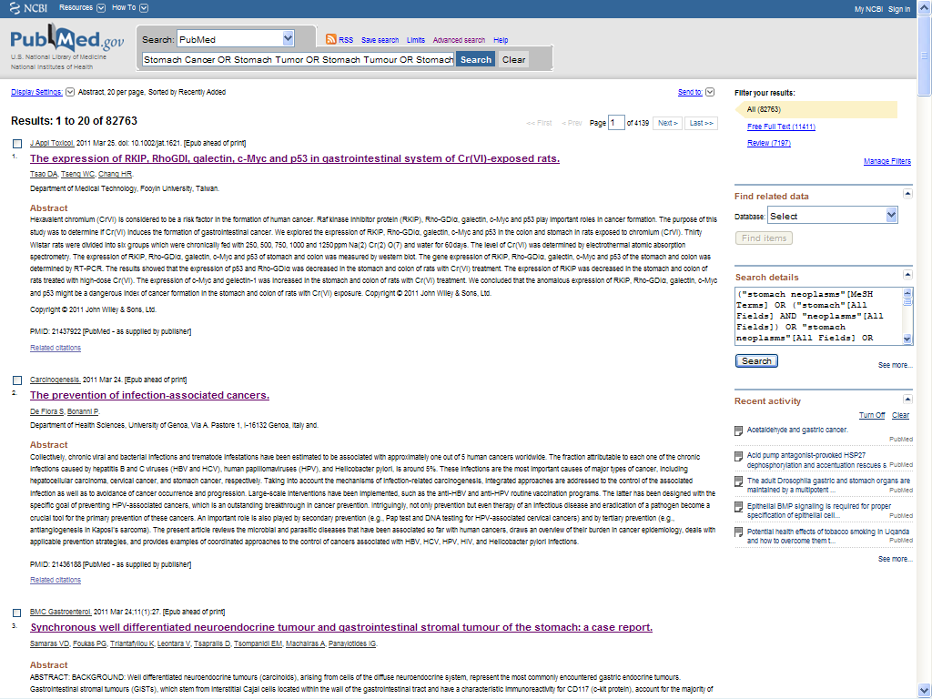


Slide 12
WHY there are so many articles not I want?
The garbage articles make me boring!!

Slide 13
自动语词转换功能
Automatic Term Mapping, ATM
在检索框中输入的不规范的词条将按照下列顺序进行匹配：
  MeSH (Medical Subject Headings) 转换表
  期刊转换表
  著者全名转换表
  著者索引
  短语表
如果没有发现匹配?
  PubMed将自动将词组拆开且重复匹配检索过程,直到发现一个相应匹配。
  没有任何匹配的词组将会在“所有的领域”里被检索。单独的词之间用逻辑AND连接。

Slide 14
More Exactly?
Stomach Cancer
  Stomach Cancer
  Stomach Tumor
  Stomach Tumour
  Stomach Neoplasm(s)
…………
…………
MeSH
Stomach Neoplasms

Slide 15

MeSH(Medical Subject Headings)
Like as Tag
Controlled vocabulary of biomedical terms that is used to describe the subject of each journal article in MEDLINE
There are 26,000⁺descriptors in MeSH

Slide 16
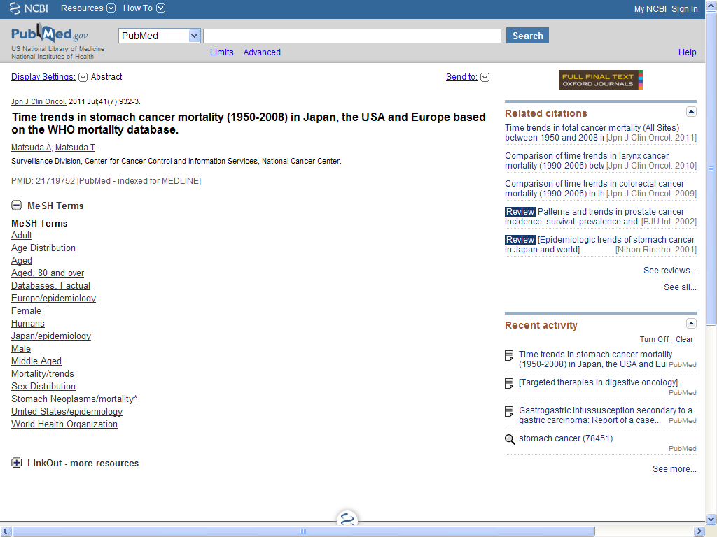

Slide 17
Controlled
Standardized

Slide 18
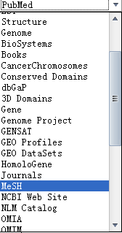

Slide 19
Stomach Cancer

Slide 20
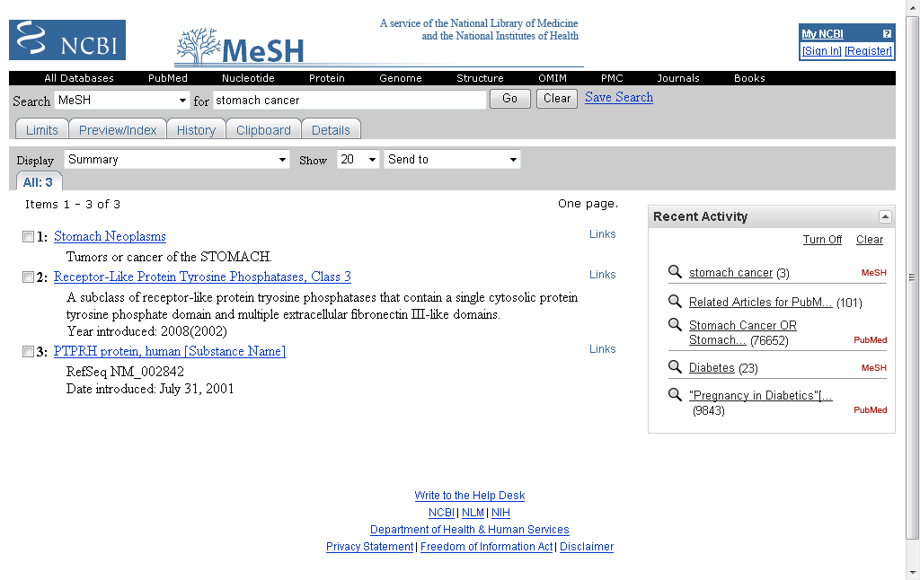
是提示界面
而非检索界面

Slide 21
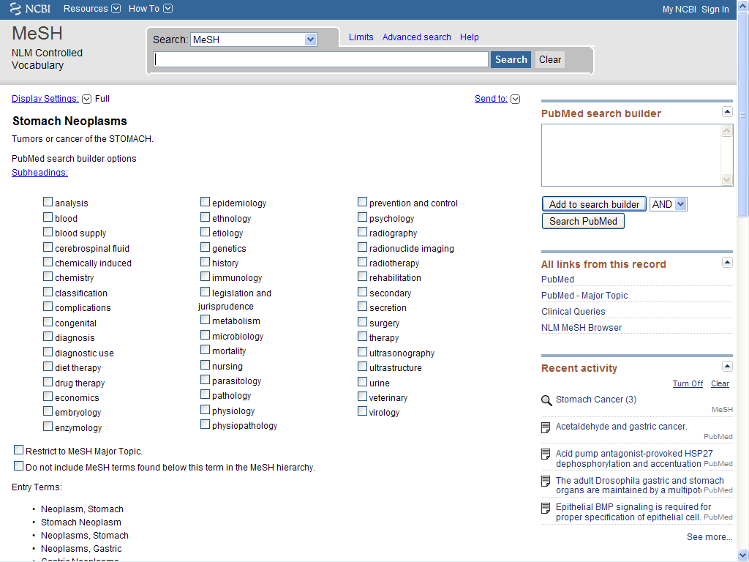

Slide 22
Subheadings
Narrow the specific focus of a main topical heading to a particular aspect of the subject.
There are 79 topical qualifiers
http://www.nlm.nih.gov/mesh/topsubscope.html

Slide 23
Tips
Operation—Surgery (Subheadings)
Drug/adverse effects
Therapy Method/adverse effects
Disease/complication

Slide 24
Sample
Therapy or Nursing
on Stomach Cancer

Slide 25




Slide 26
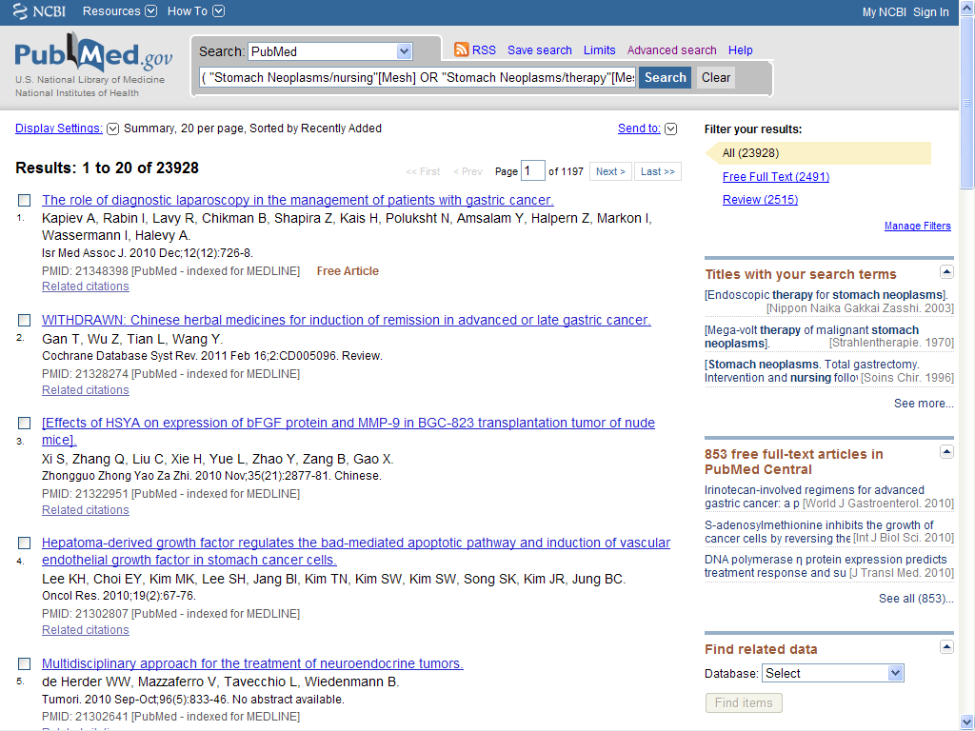

Slide 27
主要主题词

Slide 28


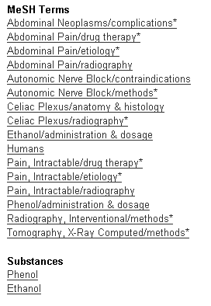

Slide 29
about 10-25 MeSH Terms
about 5 Major MeSH *

Slide 30


Slide 31
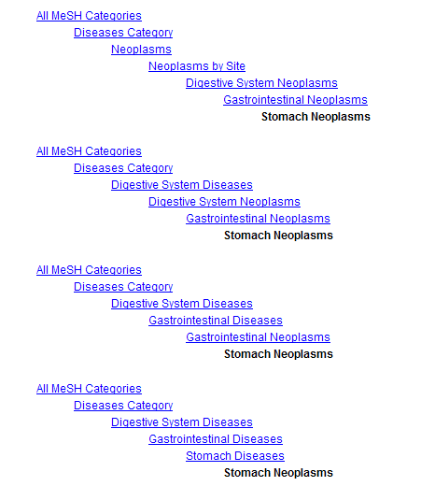
不扩展下位词

Slide 32
MeSH term is Best, So I only use MeSH!
NO? WHY？

Slide 33
简单检索与主题词检索结果对比
主题词检索可提高查准率
不是所有词都有主题词
较新或较老的文献主题词均无法查出
如何提高简单检索的查全率

Slide 34
如何在检索结果中进一步精炼结果
filters

Slide 36
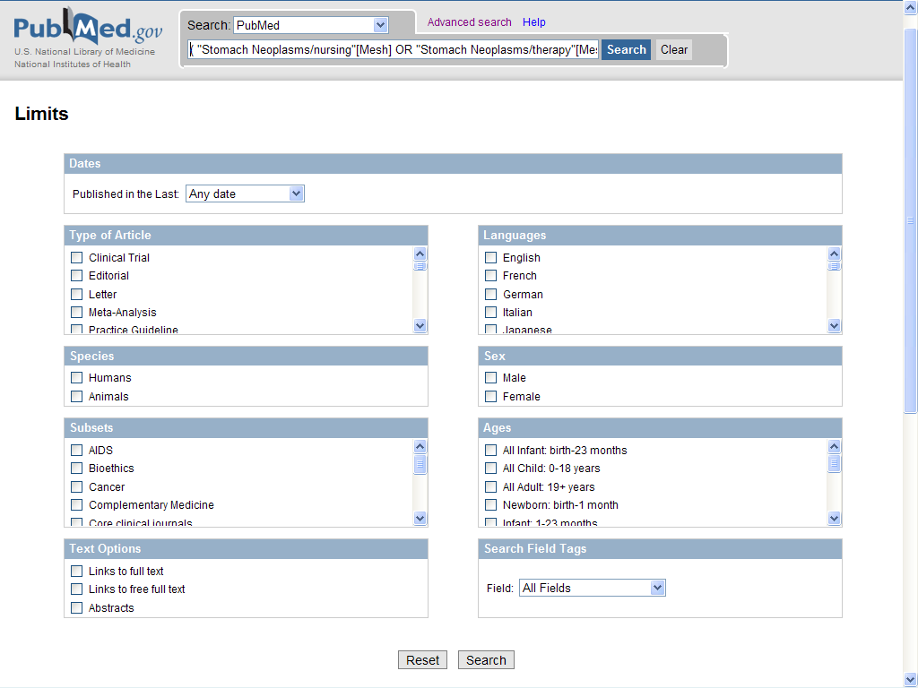
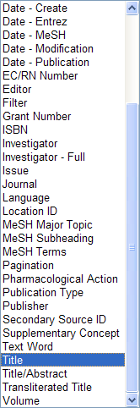





Slide 37
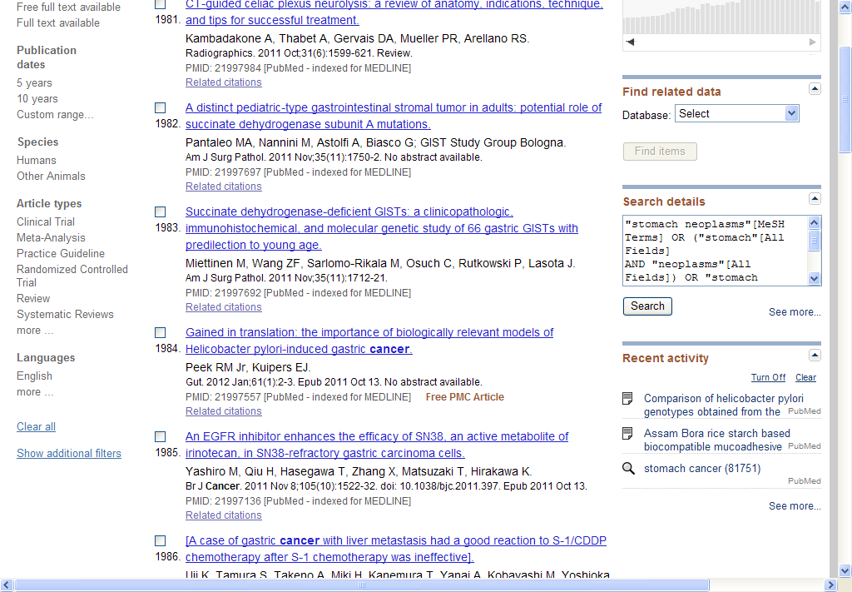
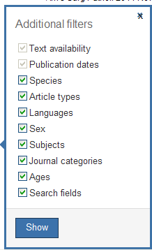

Slide 38
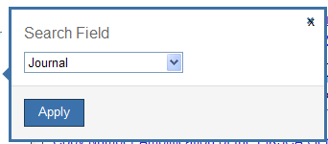
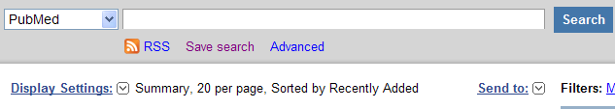
nature

Slide 39
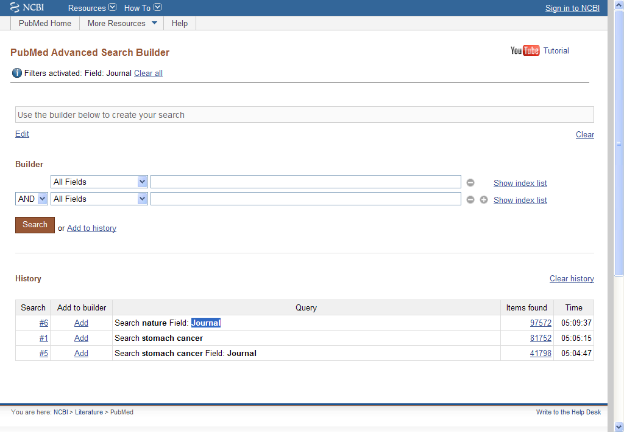
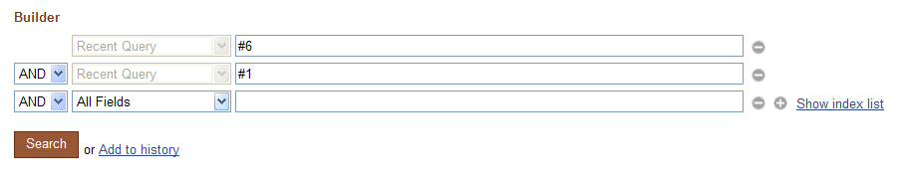

Slide 40
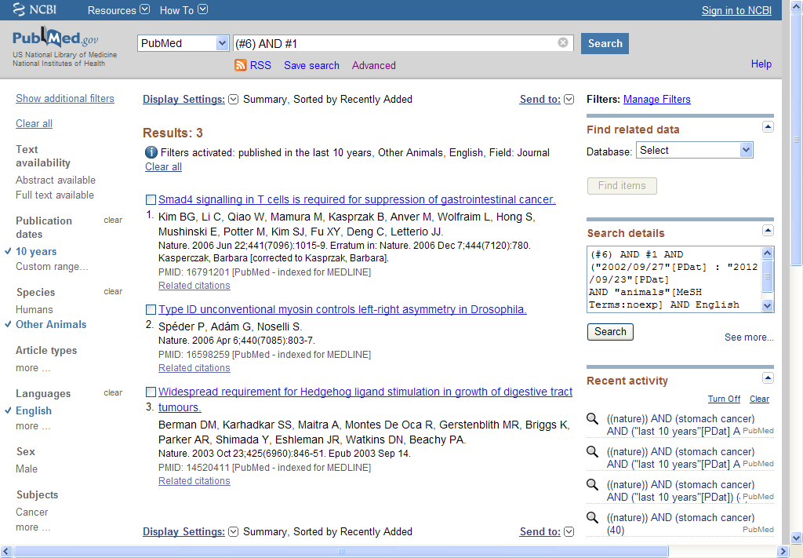

Slide 41
小结
缩小检索结果范围
  会用AND
  善用filter
  巧用majorMeSH、Subheading，不扩展下位词

Slide 42
扩大检索结果范围
  多用OR
  巧用MeSH上位词

Slide 43
Tips
Clinical Queries
Single Citation Matcher

Slide 45
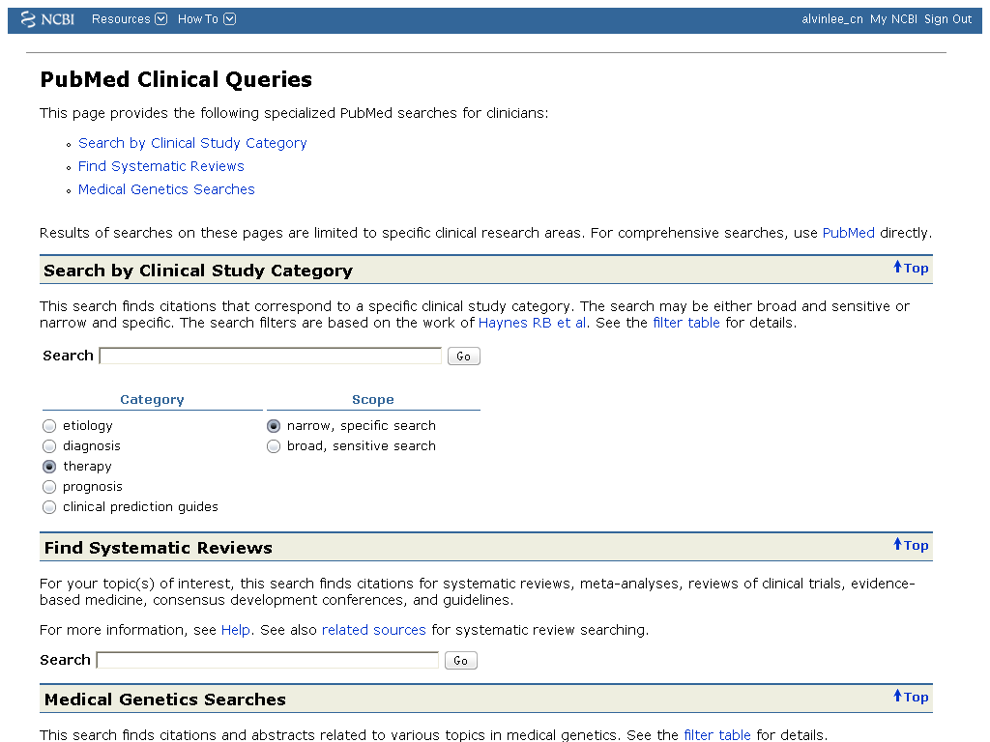

Slide 46
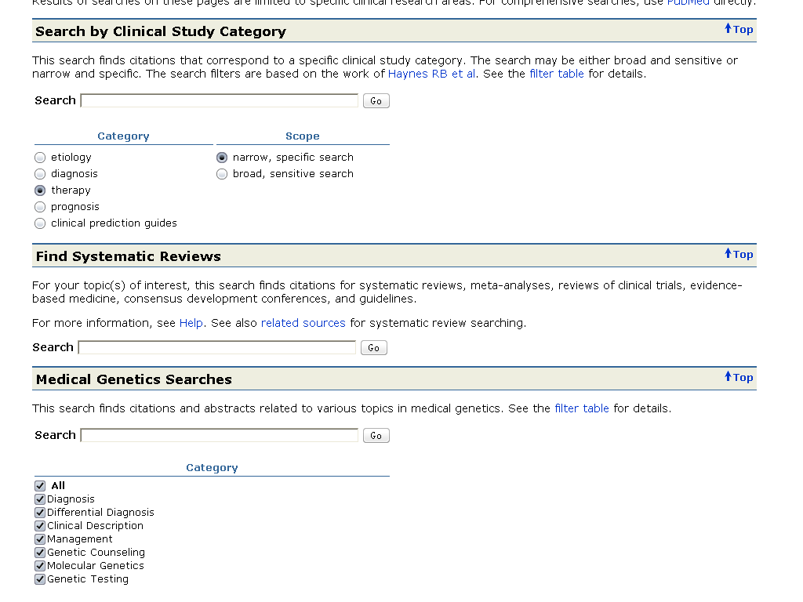

Slide 47
If I only know the title, how to search the article?
Single Citation Matcher

Slide 49
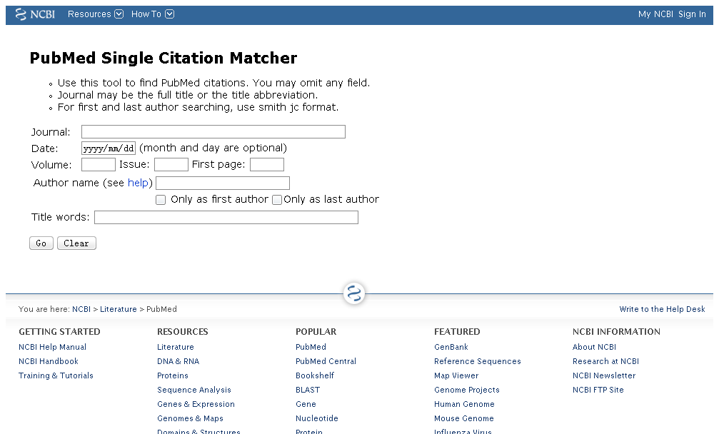

Slide 50
Sample
2008;5;387-?

Slide 51
2008
5
387

Slide 52
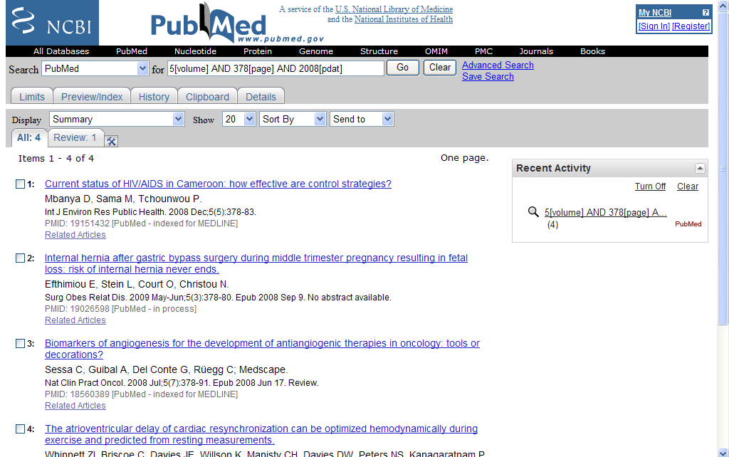

Slide 53
Can I save my results & habits?
My NCBI

Slide 55
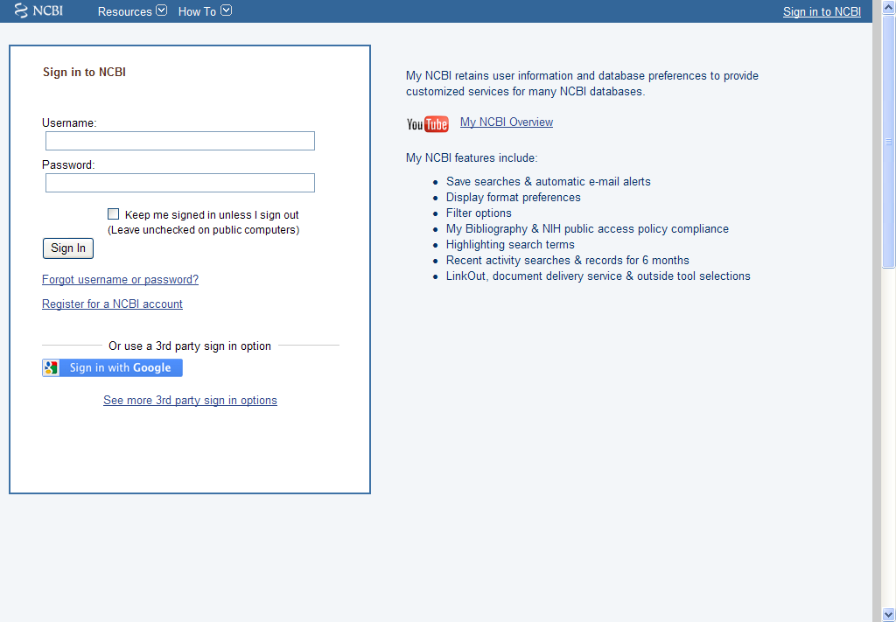

Slide 56
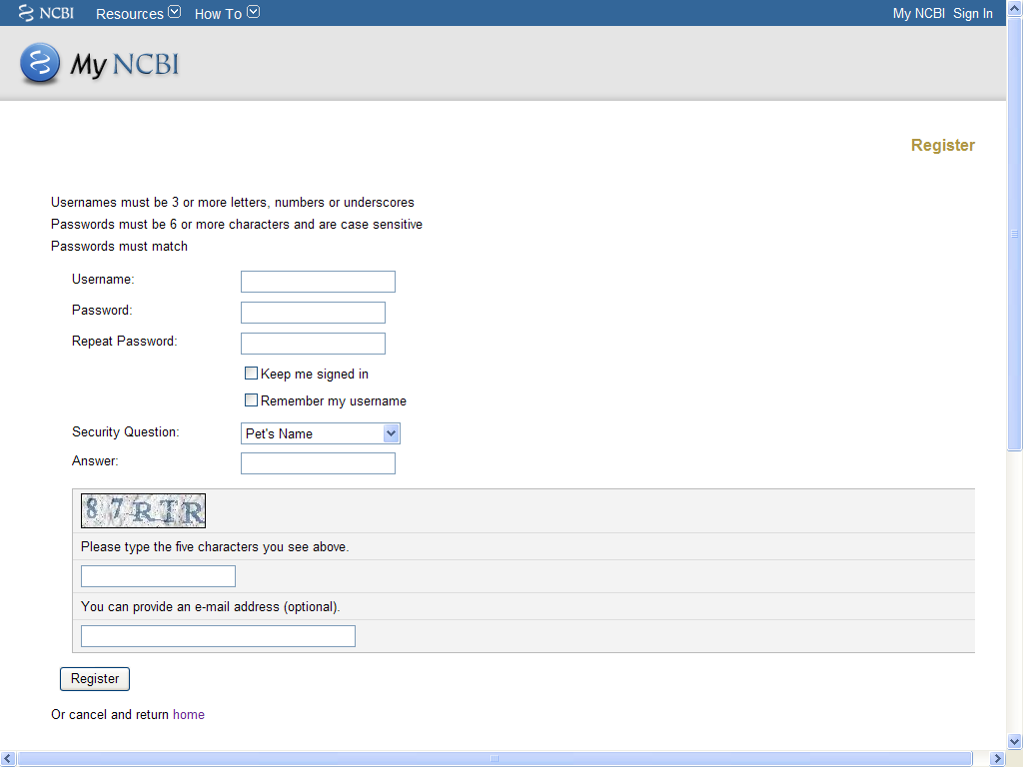

Slide 57
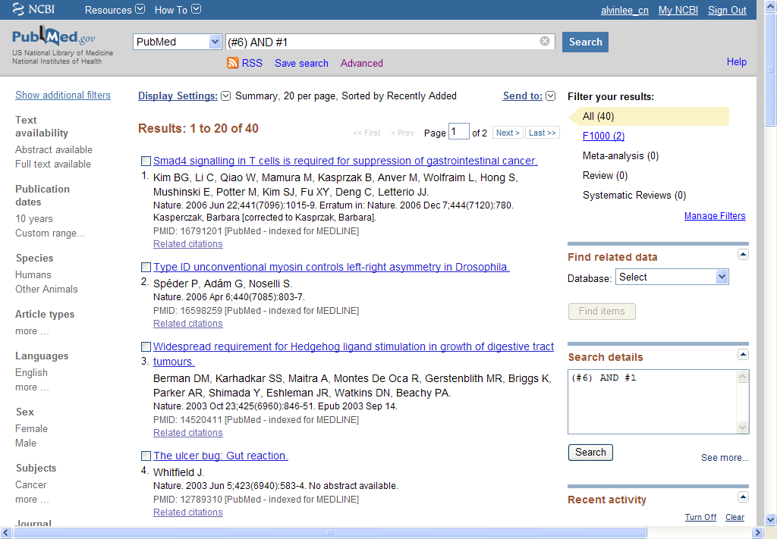

Slide 58
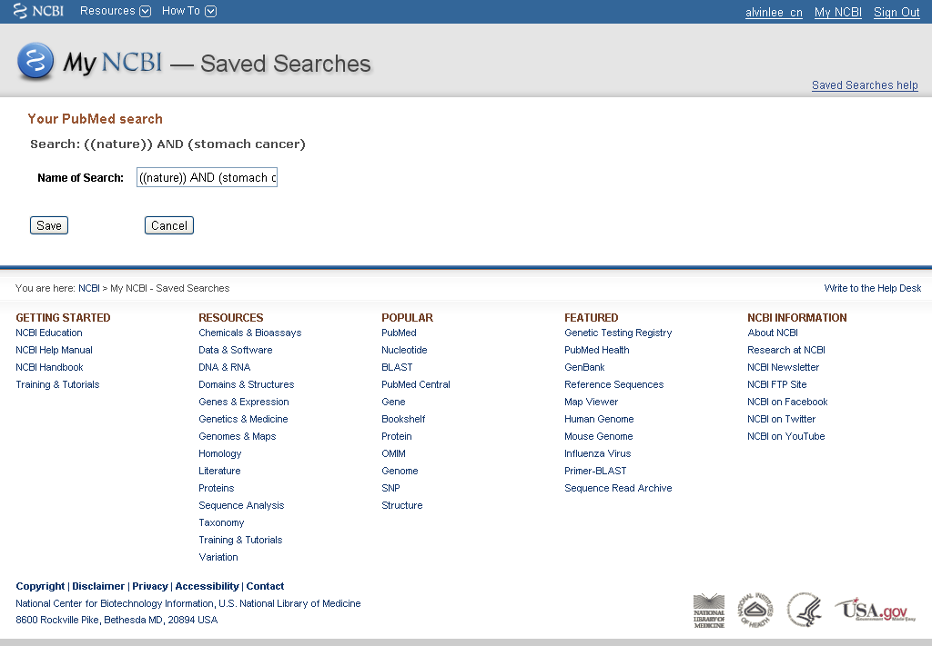

Slide 59
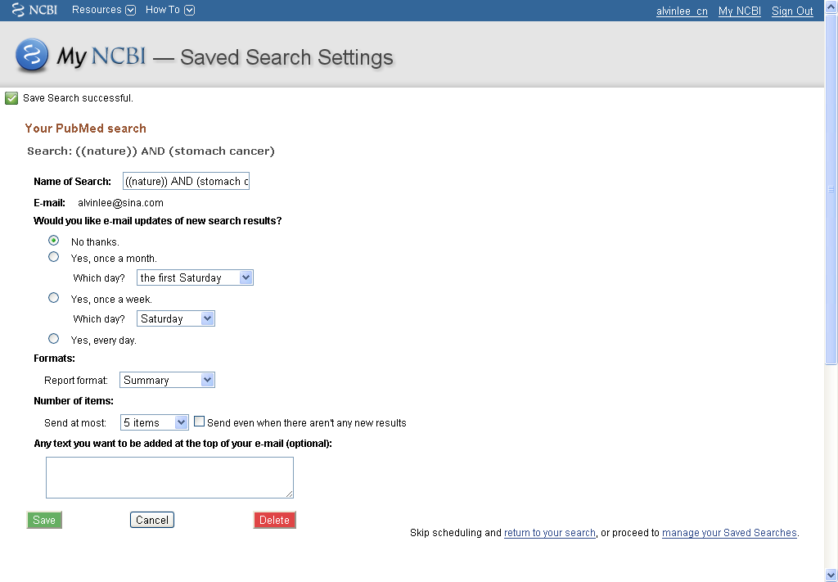
Save searches

Slide 60
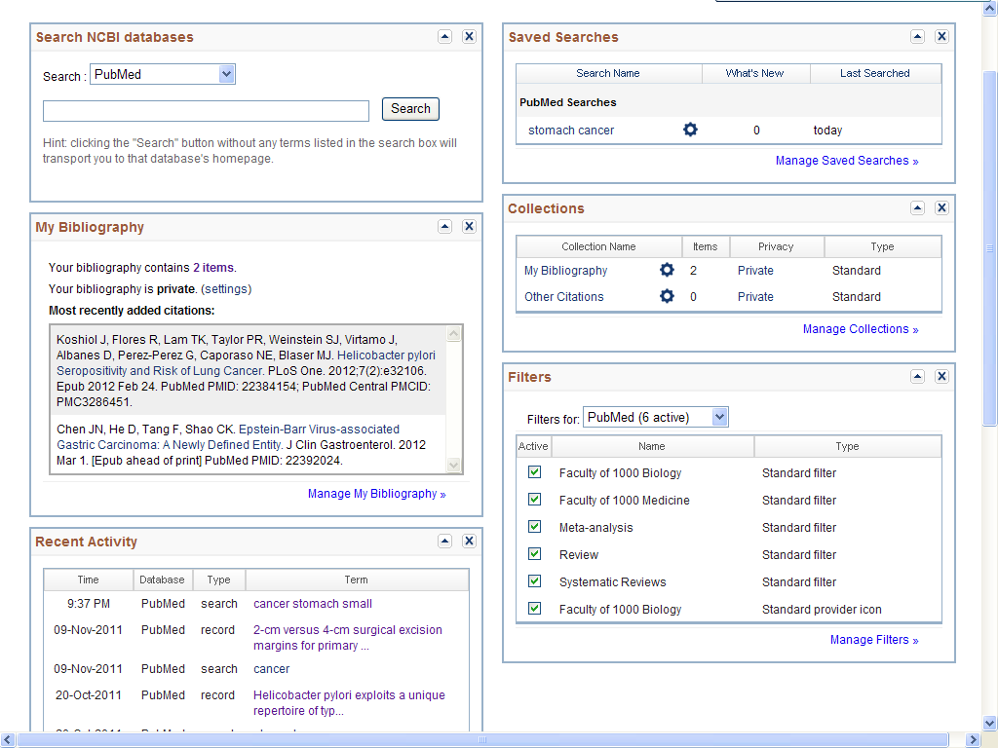

Slide 61
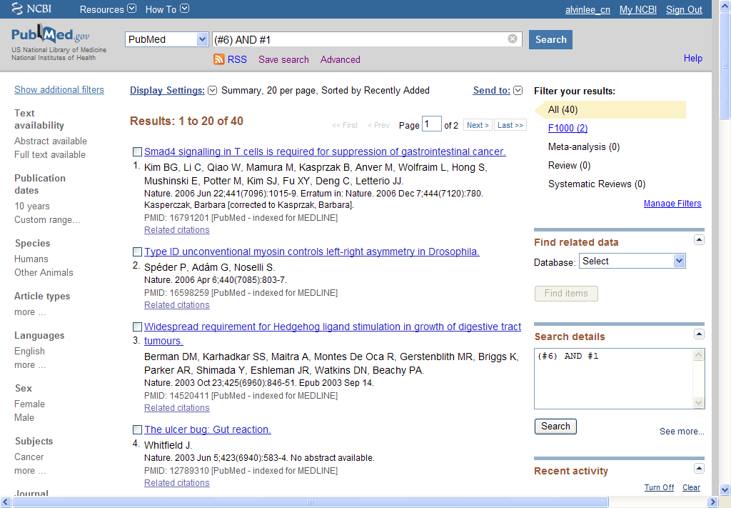
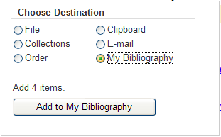


Slide 62
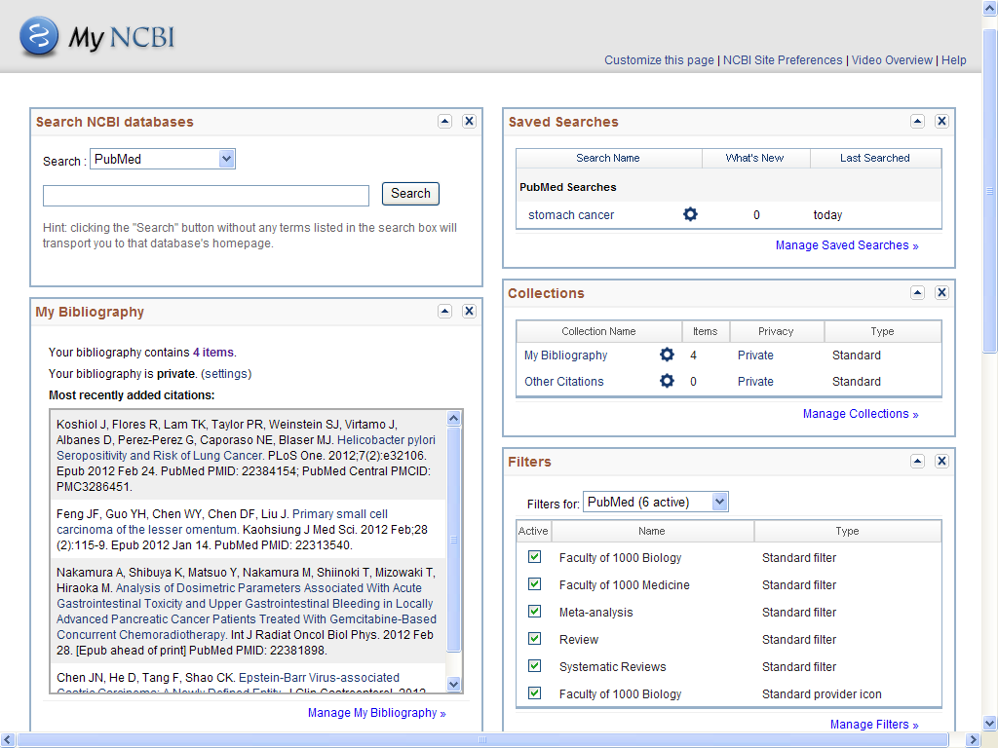

Slide 63
过 滤 器

Slide 64
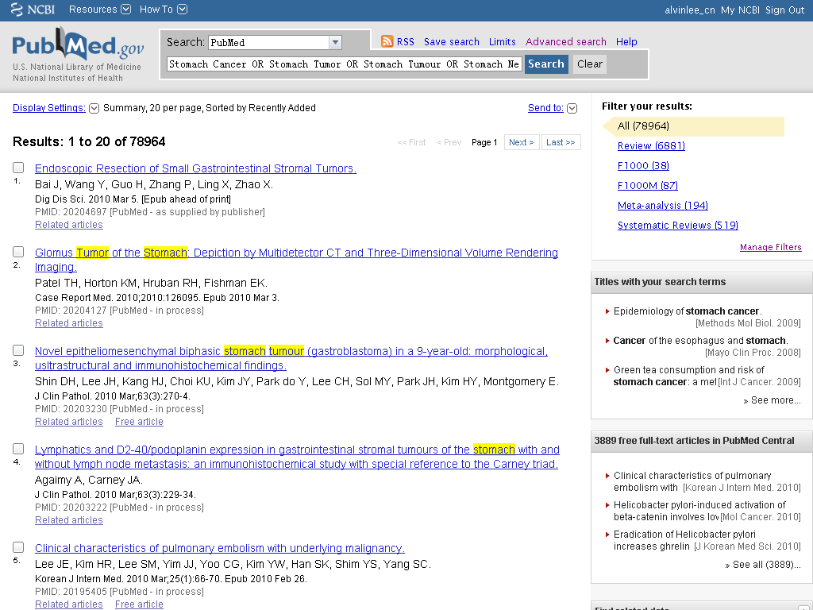

Slide 66
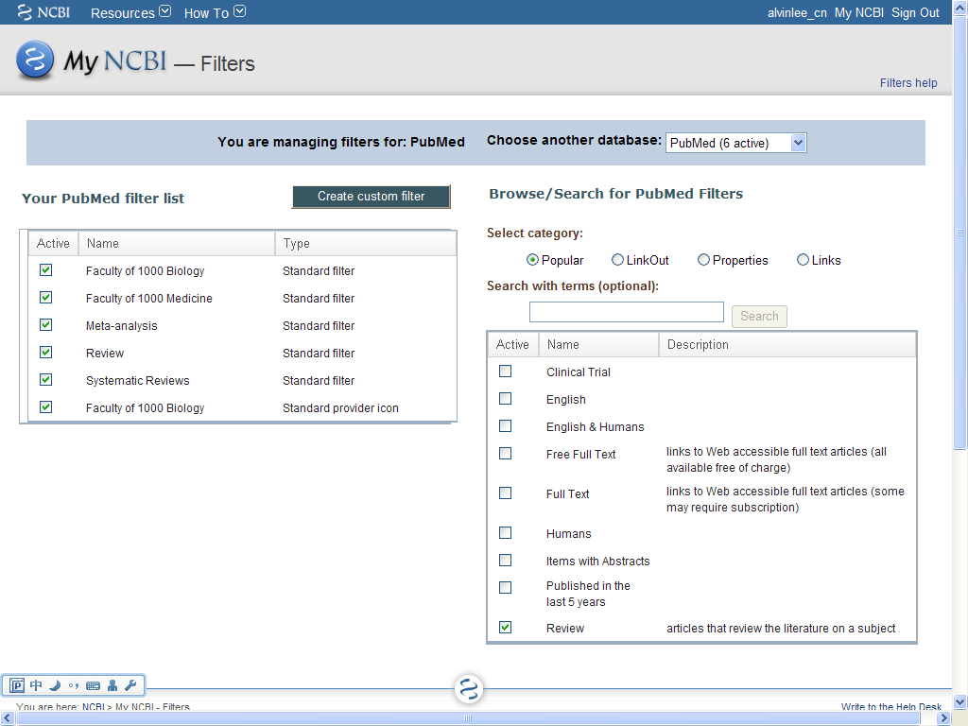

Slide 67
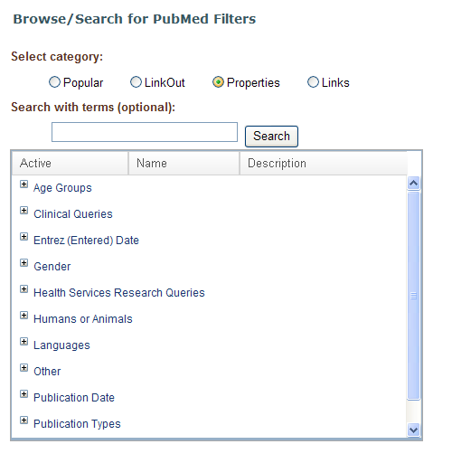

Slide 68
meta

Slide 69
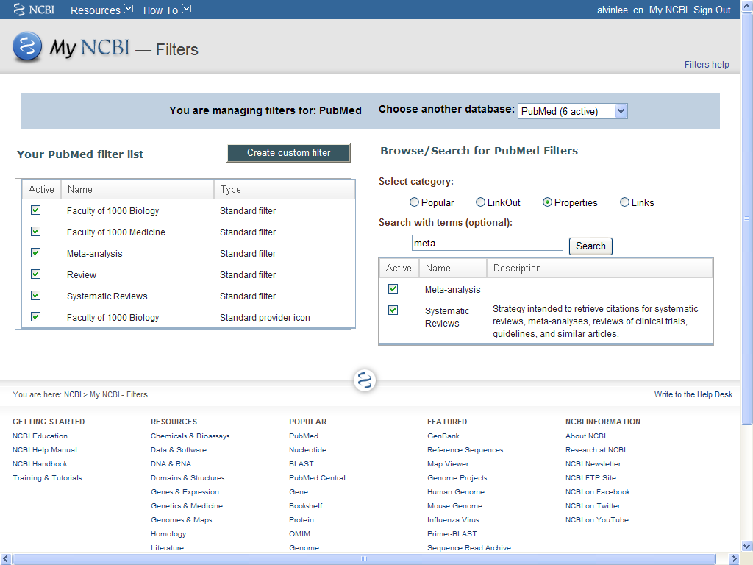
Recommend

Slide 70
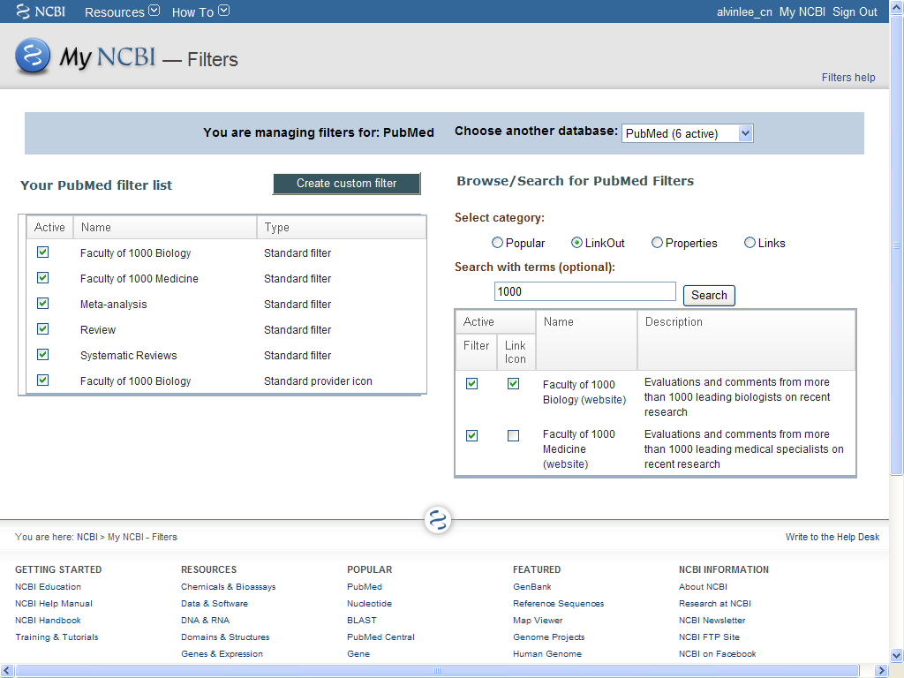

Slide 71
F1000 (Faculty of 1000)
Continuously updated selections and evaluations of the most important articles
Attributed opinions and expert knowledge from global leaders in biology and medicine
Site customization and email alerts based on user interests
Recommendations and interpretations based on the article's merits, not the journal's

Slide 72
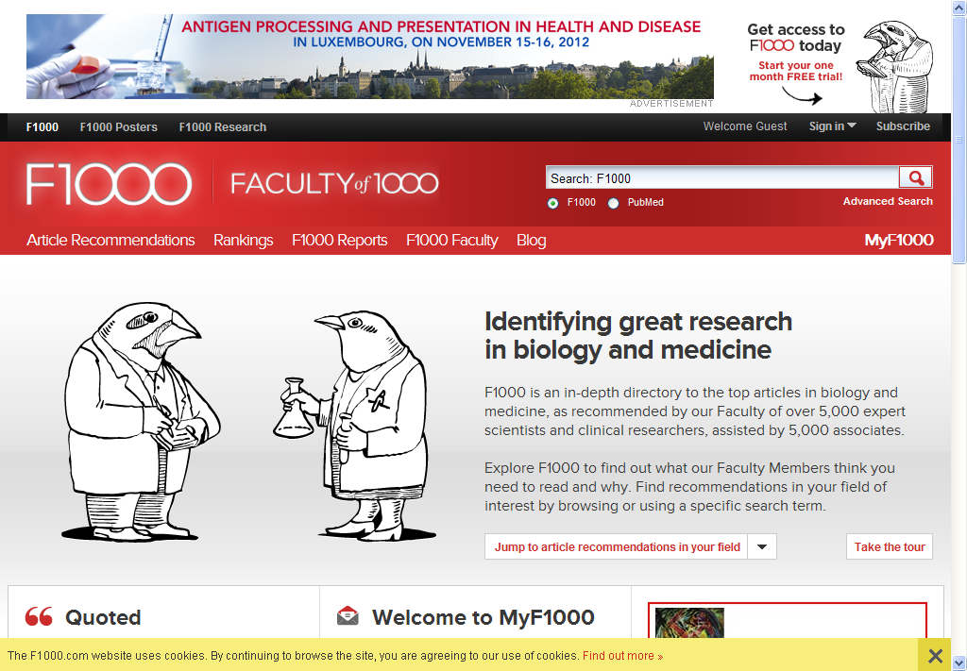

Slide 73
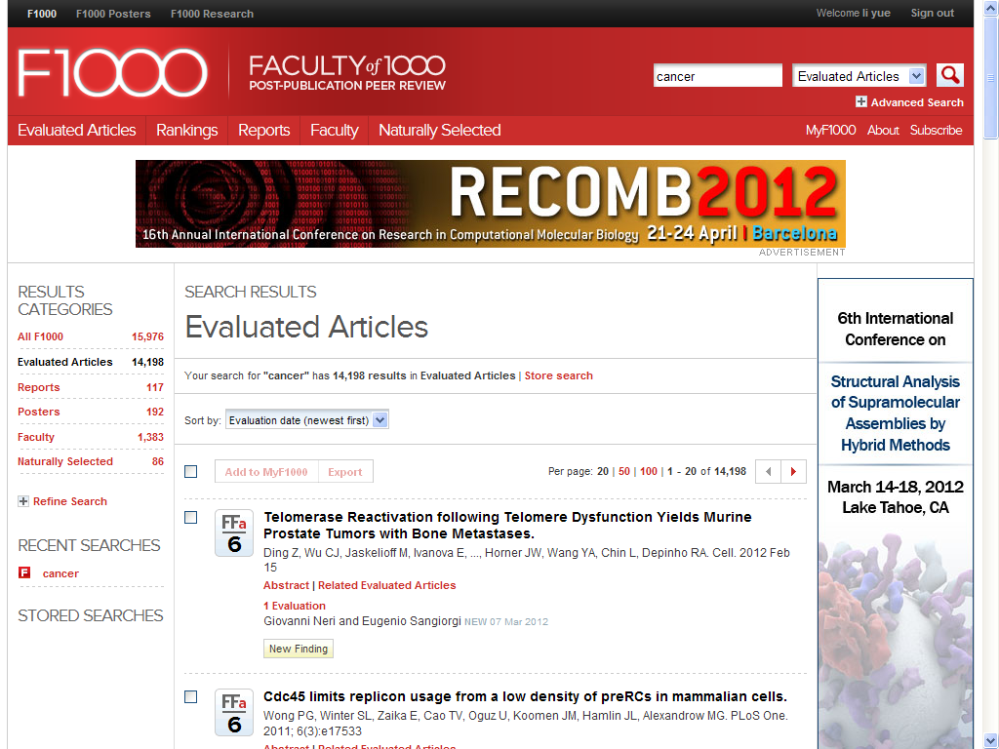

Slide 74

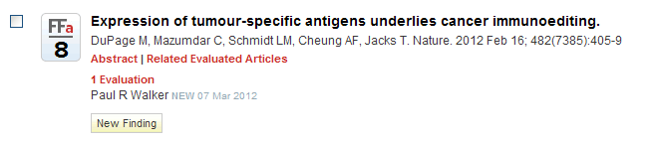
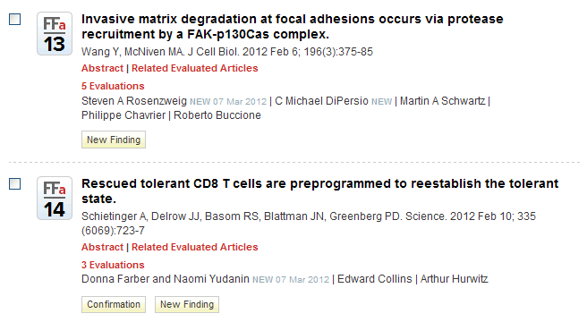
Recommended
（6-7）
Must Read
（8-9）
Exceptional
10+

Slide 75
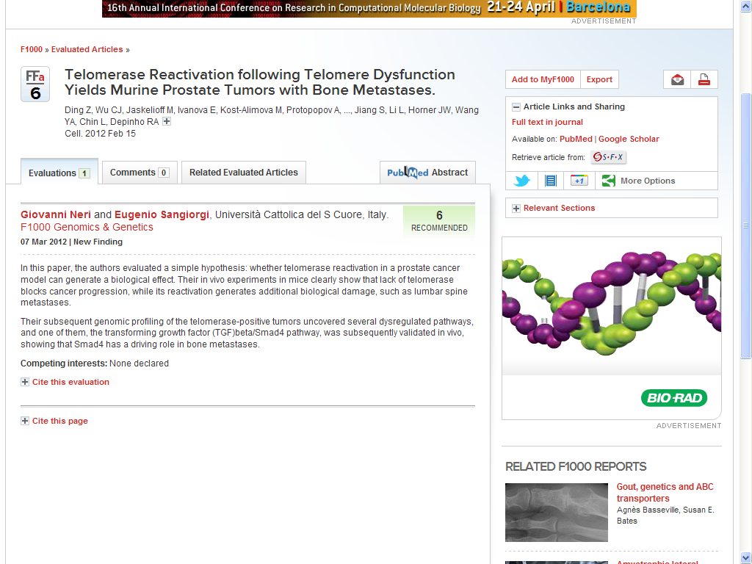

Slide 76
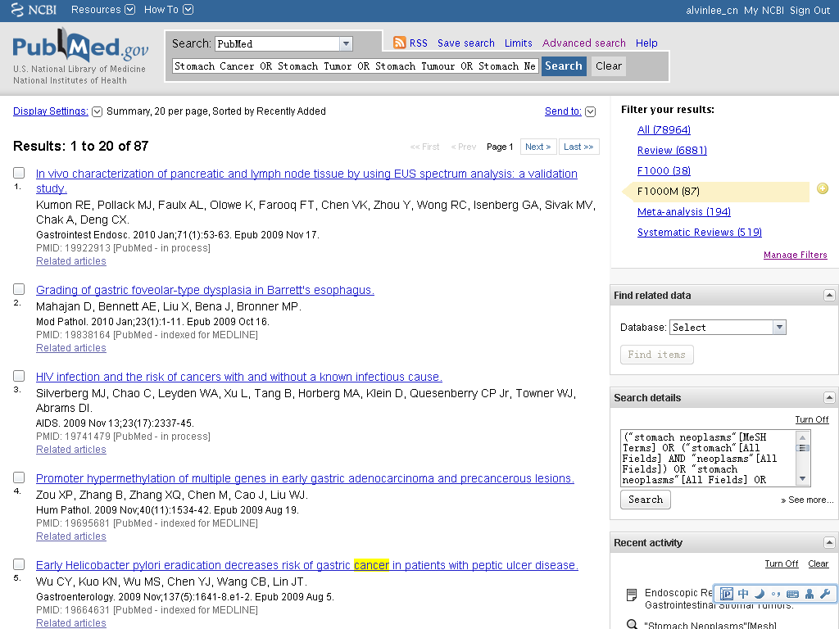

Slide 77



Slide 78



How can I analysis the articles?

Slide 80
GoPubMed
Based on PubMed Database
Gene Ontology AND MeSH
Analysis
It`s FREE!!
www.gopubmed.com

Slide 81


Slide 82


Slide 83


Slide 84




Slide 85



Slide 86


Slide 87


Slide 88
谢 谢 观 看
中国医学科学院医学信息研究所
黄利辉

