Slide 1
PubMed整合显示图书馆电子资源
医科院图书馆电子资源培训讲座

Slide 2
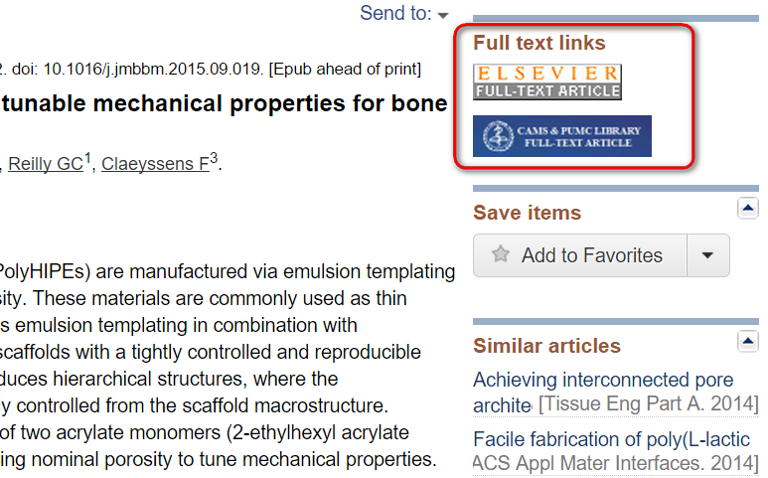
PubMed LinkOut
Links to full text resources from PubMed are available through a service called LinkOut.
When you click on LinkOut icons or links in the LinkOut display in PubMed, you leave PubMed and are directed to the full text at an external site.
You can use LinkOut to determine whether our Medical Library provides electronic full text for a journal article.

Slide 3
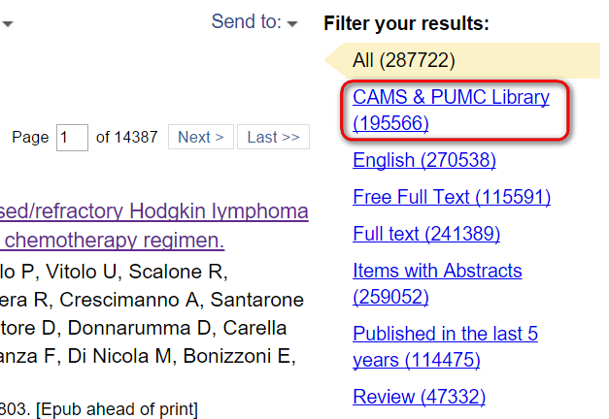
Filters (My NCBI)
Filters allow you to restrict your search by date, article type, and other characteristics.
My NCBI allows you to set and retain filters between PubMed sessions using your My NCBI account.
Click this tab to view citations that are available through our Medical Library. PubMed will filter your results and provide only the article citations for which our Medical Library has access.

Slide 4
轻松使用
http://www.ncbi.nlm.nih.gov/pubmed?holding=icncamslib
http://www.ncbi.nlm.nih.gov/pubmed?myncbishare=camslib

Slide 5
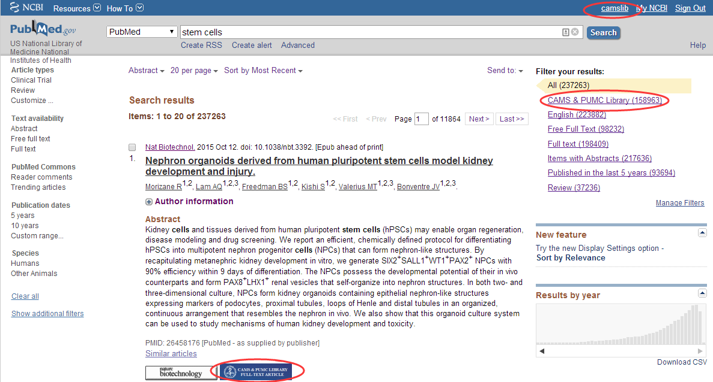
注册使用 PubMed

Slide 6
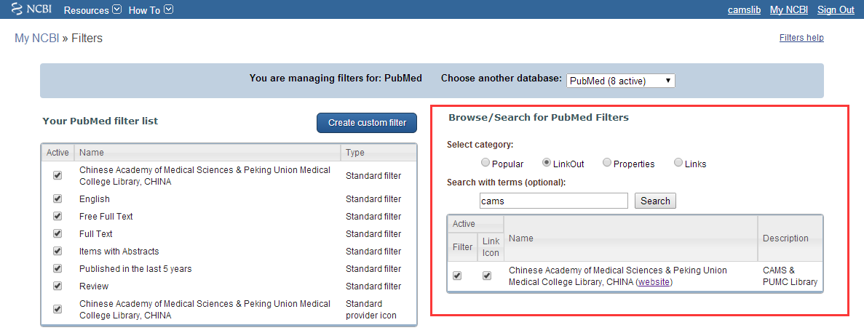
添加 Filter & Link Icon

Slide 7
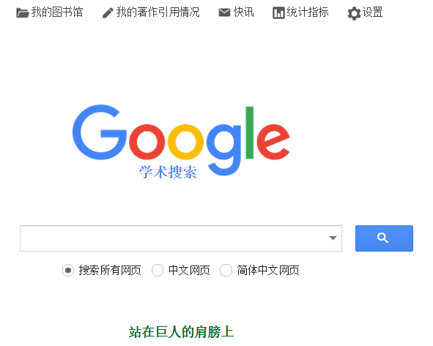
Google Scholar

Slide 8
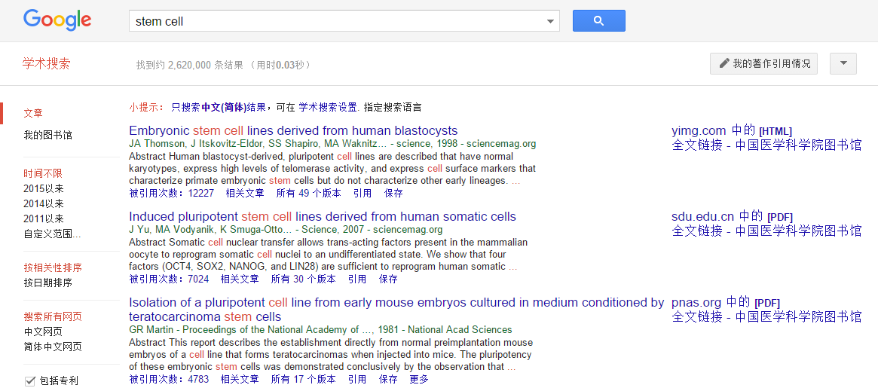
Google Scholar

Slide 9
感谢您的参与
了解更多关于图书馆电子资源使用的内容欢迎继续参加我们的系列培训讲座
中国医学科学院/北京协和医学院 图书馆
2015—2016学年第一学期电子资源培训讲座
Notes:
在 “幻灯片放映”模式，单击箭头进入 PowerPoint 入门中心。

