Slide 1
Notes:
Guide to a successful PowerPoint design – simple is best
Use the template wisely, make design amends that help your communication, do not alter the core design of the slide.
Use only one key message per slide. If you have more than one message, use more slides.
Some argue the target number of words on a slide should be 6. Limit the amount of text on each slide, and include copy in your notes.
Maintain a consistent design throughout - colours, fonts, graphics and images.

Slide 2
把证据带进临床
BMJ Best Practice . 2014
Notes:
Design tips - narrative
Always consider your audience, who are they, what do they expect, how much will they know, what are the key messages they need to take away?
Tell a story - have a beginning a middle and an end.
Slides should follow a natural progression.
Remember the three times rule - tell your audience what you are going to tell them, tell it, and then summarise it.
Design tips – colour and images
Avoid using all the available colours. Blue is always our core colour, try not to use more than 2 secondary colours from the palette and only one secondary colour can be used on any given slide.
Use images carefully. They should help the audience relate slide information to real world situations. Always ensure good legibility is maintained when text is placed over images.
Do not use clipart.
Use graphics after careful consideration. Only use them if it adds to the communication.
Additional logos – for partners or other parties you co-present with – please place the logo in the bottom right hand corner

Slide 3
Types of Evidence-based Information
Systematic Reviews and Meta-analyses
Case Series
Case Reports
Ideas, Editorials, Opinion
Full-Text Journal Articles
Cohort Studies
Case Control Studies
Randomised Controlled Double Blind Studies
Source: Medical Research Library of Brooklyn

Slide 4
The burden of evidence is significant
…although figures vary
35,000 biomedical journal articles published annually
150,000 articles / month
120,000 RCT/year
500,000 articles are indexed in PubMed every year

Slide 5
临床决策（诊疗系统）之效率
15个城市，121家三甲医院，7321份问卷
工具 | 应用比例 | 解决时长
Google | 49% | 31分钟
百度 | 47% | 27分钟
丁香園 | 46% | ??
清华同方 | 33% | 33分钟
万方数据 | 31% | 37分钟
Pubmed | 21% | 46分钟
2008-2009，邓白氏调查

Slide 6
临床决策（诊疗系统）之效率
2581名中国临床医生调查
Study to show effectiveness of full-text for various purposes of a clinicians time
有73.7%即使完全读懂全文内容（中文/英文），仍对其临床诊疗无任何帮助(5分制选0分和1分)。
项目 | 时间比例 | 全文效力 （5分制） | 结论
治疗 | 79.2% | 1.72 | 無效
继续教育 | 11.1% | 2.88 | 有限
研究 | 8.6% | 4.69 | 推薦
其他 | 1.1% | NA | NA
2009-2010，邓白氏调查

Slide 7
Why Best Practice? – 权威
全新的临床决策指导工具
Brand new approach to clinical decision support
全球6,000多知名临床专家执笔撰写
Written, compiled and reviewed by over 6,000 experts around the world
提供国际权威指南和定制国内标准和指南
Provides NICE Guidelines and allows for adding of institutional guidelines locally

Slide 8
Why Best Practice? – 高效
包括基础，预防，诊断，治疗和随访等各个关键环节的内容
Content patient consultation from Basics, Prevention, Diagnosis, Treatment to Follow-up
疾病评估专论及鉴别诊断包含超过10,000项诊断指引，让临床医生能迅速解答临床问题
Includes over 10,000 diagnoses in Assessments and Differential Diagnosis to help clinicians answer questions quickly

Slide 9
Why Best Practice? – 高效
把循证医学带进临床
Brings EBM practice into the Clinical Practice setting
连接Martindale药典
Direct access to drug database – Martindale
远程访问和移动电话版本
Remote access and mobile phone access

Slide 10
Content
Best Practice主要提供两种标准结构界面
疾病诊治标准界面
提供疾病的详细内容，包括诊断治疗等讯息。

Slide 11
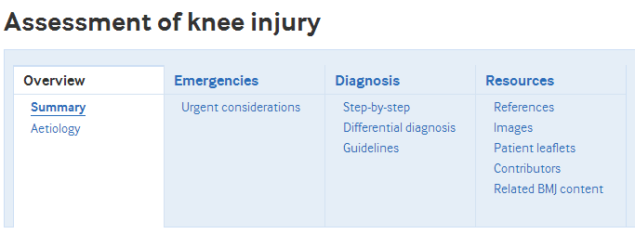
Content
Best Practice主要提供两种标准结构界面
分析评估界面
分析症状(e.g., chronic cough)
临床发现(e.g., peripheral oedema)
诊断测试结果 (e.g., metabolic acidosis)

Slide 12
A Case Example

Slide 13
A Case Example
临床问题:
A 70-year-old man is discovered by a family member to have difficulty speaking and extreme balance difficulty.
The family member brings him to you in the Emergency Ward.
He was last known to be fully functional 1 hour ago when the family member spoke to him by phone. There is a history of treated hypertension and diabetes.
How should you proceed with assessing and managing this patient?

Slide 14
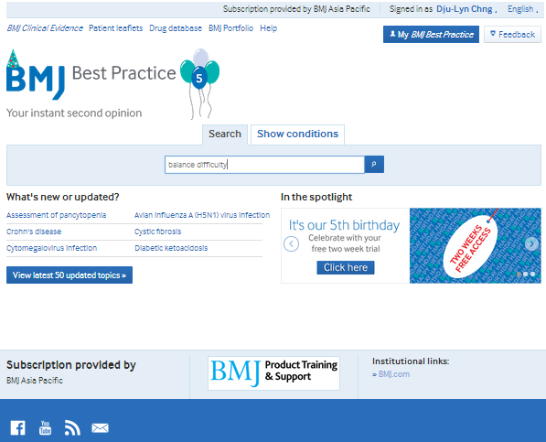
A Case Example
Where to begin? - Symptom Searching
(症状查寻)

Slide 15
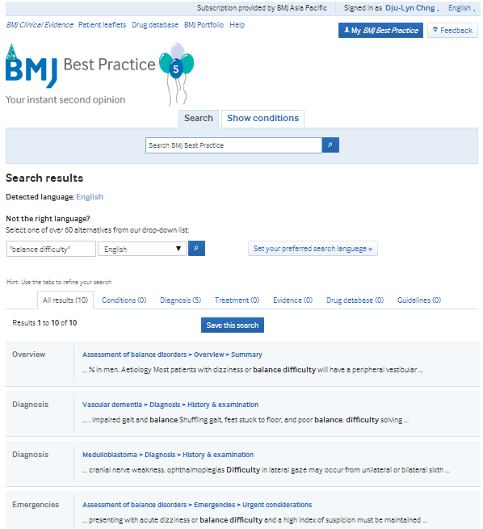
A Case Example
Find your results
(查寻结果)

Slide 16
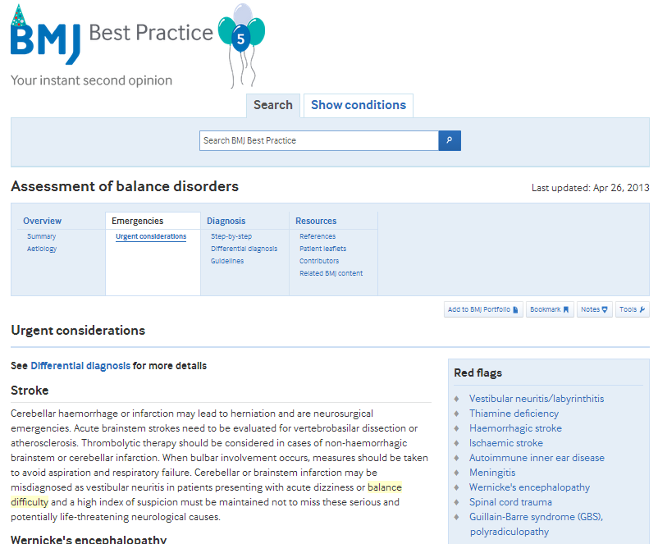
A Case Example
Assessment Details
(分析内容)

Slide 17
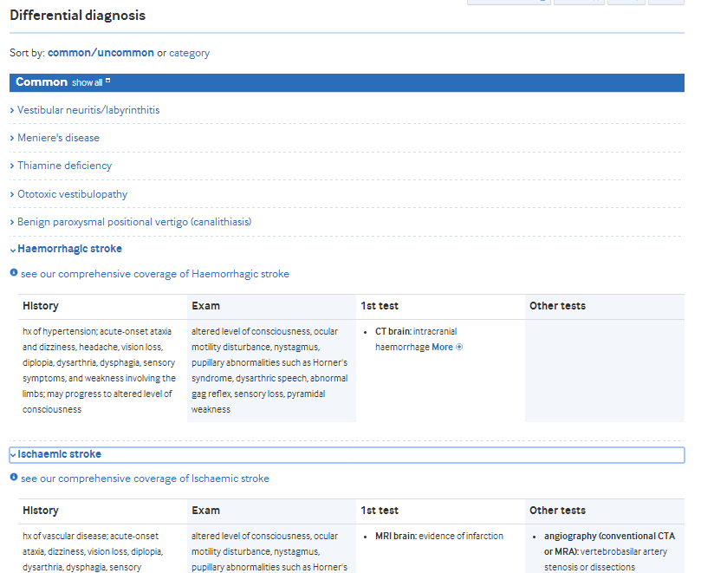
A Case Example
Differential Diagnosis (鉴别诊断 )

Slide 18
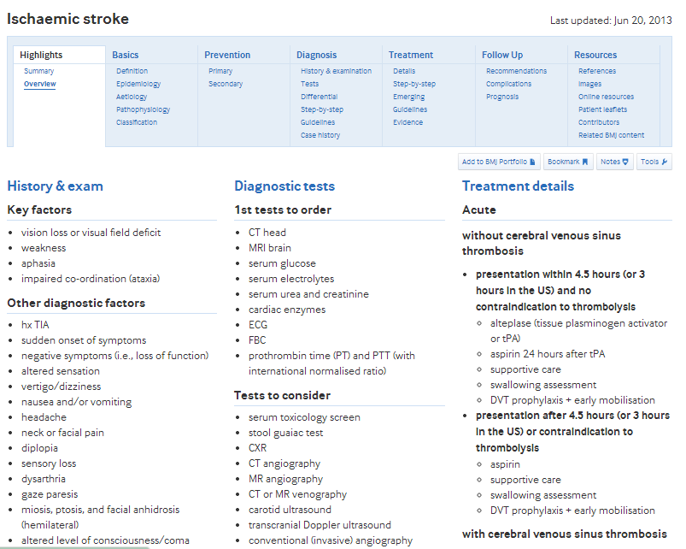
A Case Example
Condition Details
(疾病内容 )

Slide 19
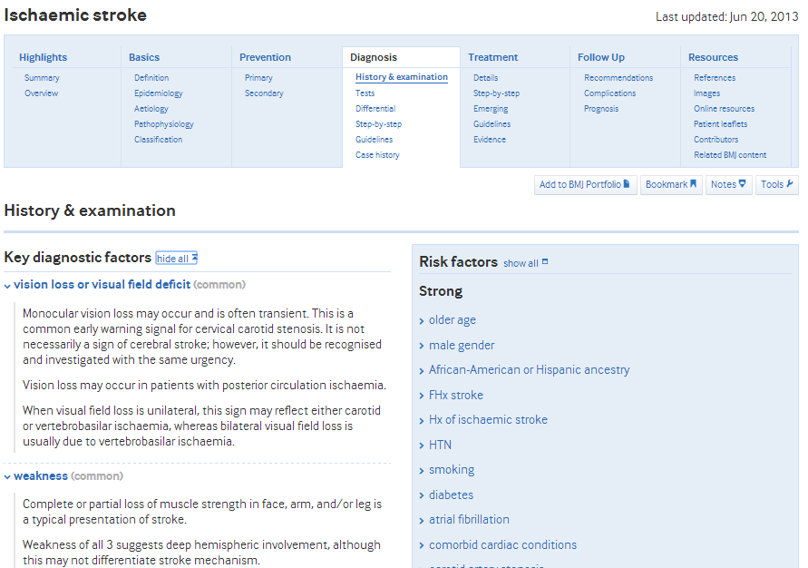
A Case Example
Diagnosis – History & Examination (诊断 – 病史与检查)

Slide 20
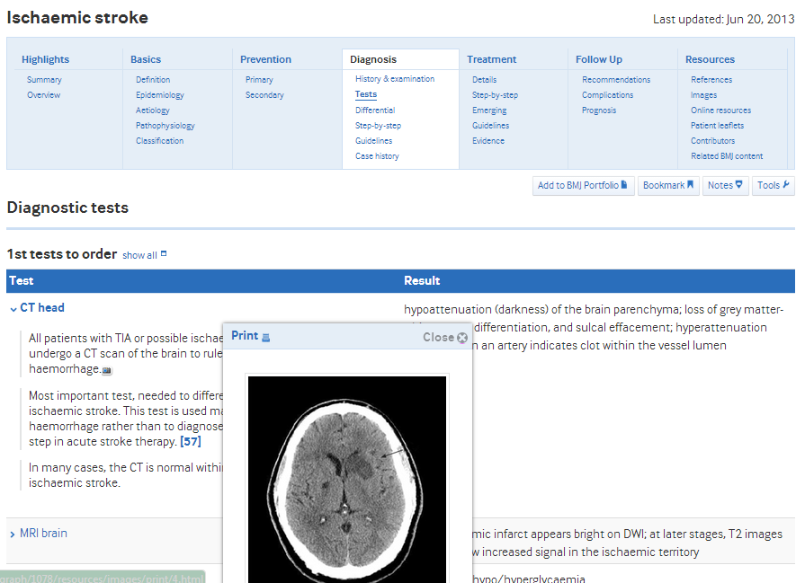
A Case Example
Diagnosis – Tests
(实验室检查 )

Slide 21
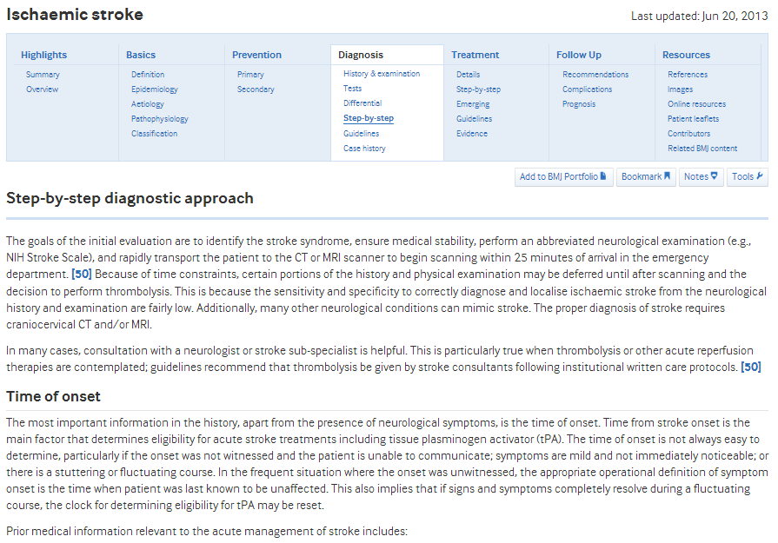
A Case Example
Diagnosis – Step-by-Step (诊断步骤)

Slide 22
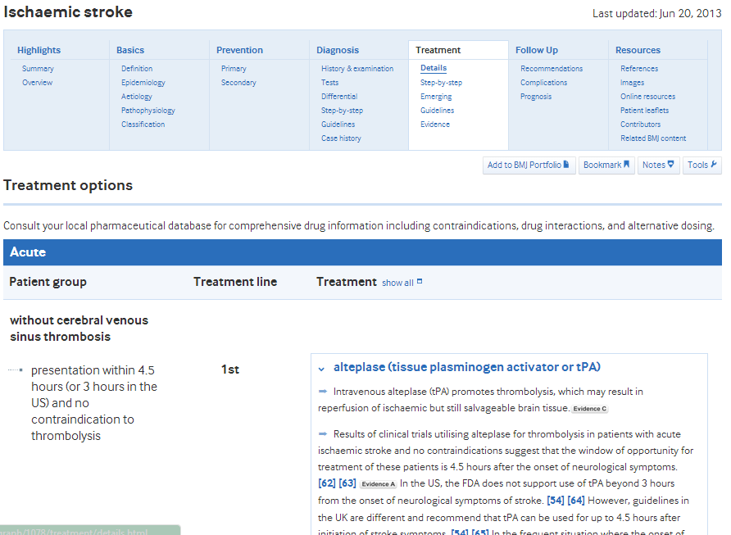
A Case Example
治疗具体方法: 确认患者群 +选择治疗方案

Slide 23
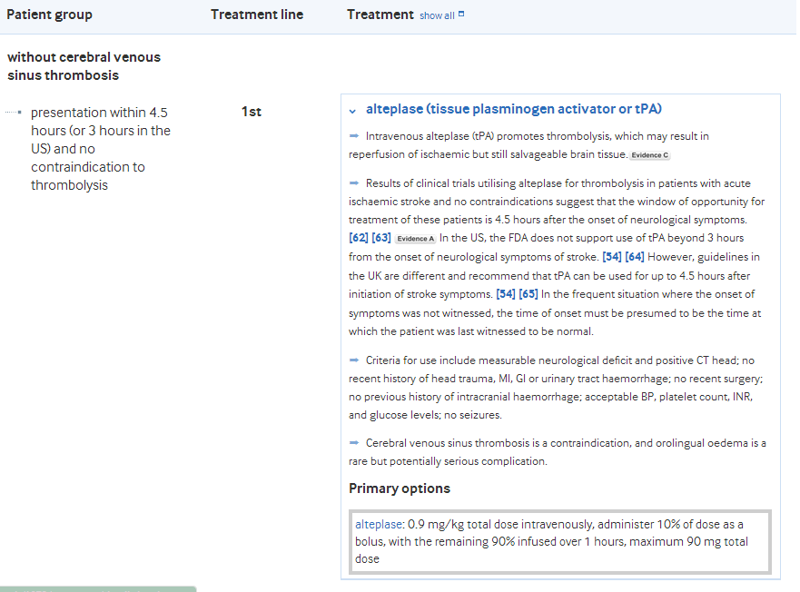
A Case Example
Treatment – 进入“马丁代尔”药典查看更多药物作用信息

Slide 24
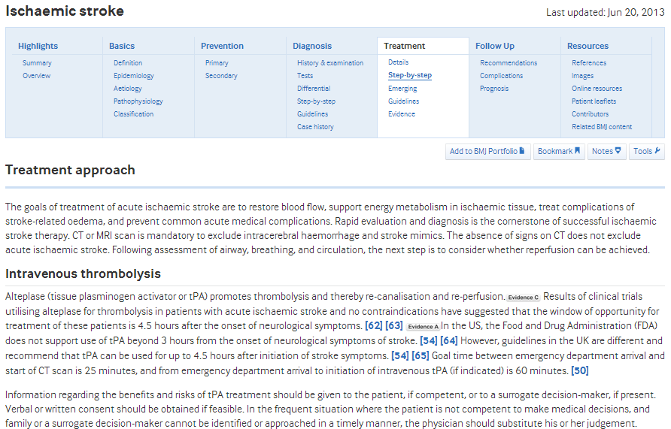
A Case Example
Step-by-Step – Supported by Evidence

Slide 25
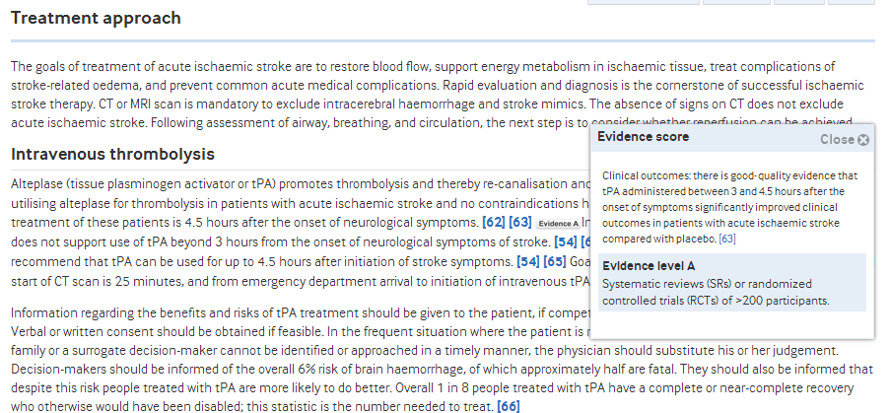
A Case Example
Step-by-Step – Supported by Evidence

Slide 26
Other Features

Slide 27
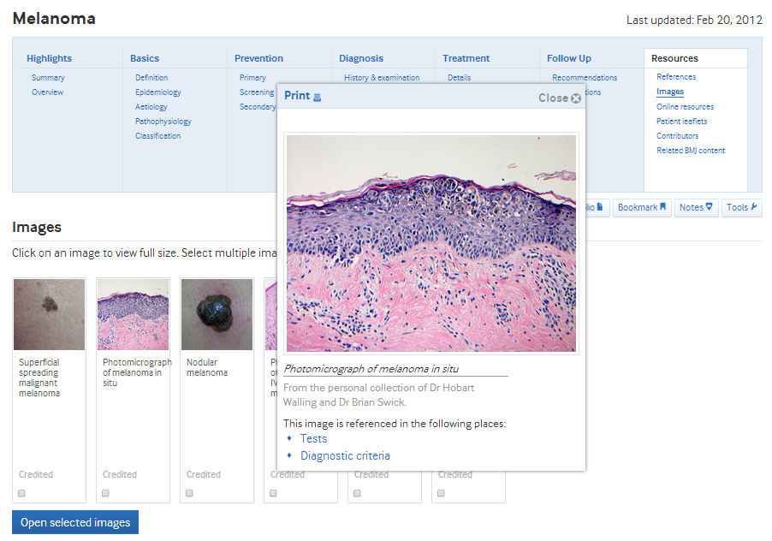
Other Features
Images for reference 提供大量彩色图像

Slide 28
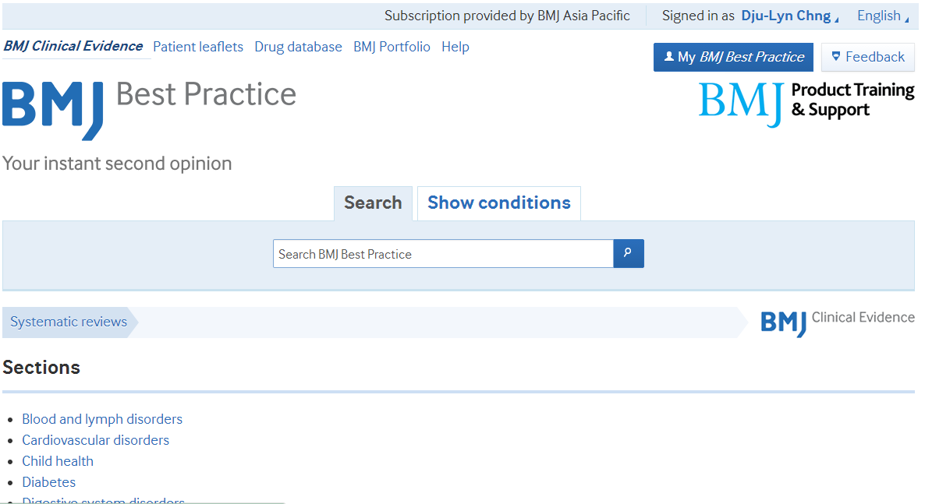
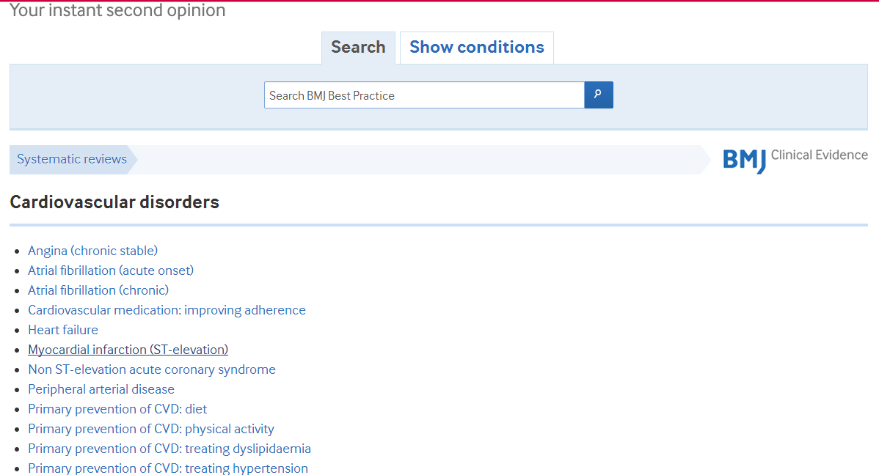
Browse through Clinical Evidence content

Slide 29
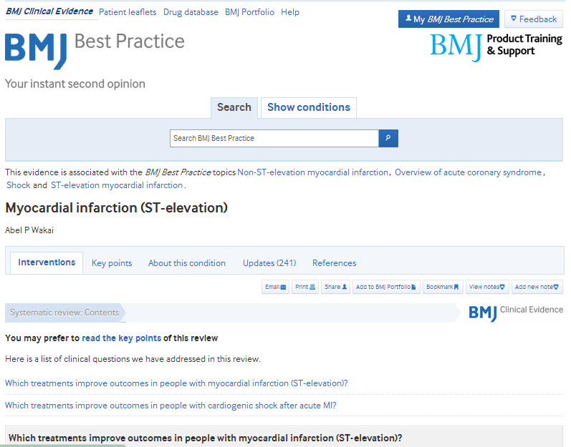
Full Content from Clinical Evidence

Slide 30
Thank You
Web: bestpractice.bmj.com
Email: dlchng@bmj.com
BMJ Publishing Group Limited 2013. All rights reserved.

